Slide 1
EE 312 – Software Implementation I
Complexity - 1
Vallath Nandakumar
University of Texas at Austin

Slide 2
DEFINITION OF ALGORITHM
Definition of Algorithm
  Any well-defined computational procedure
  Takes some value or set of values as input
  Produces some value or set of values as output
Algorithm
  Sequence of computational steps that transforms input to output
  Tool for solving well-specified computational problem
  “Correct” if for every input instance halts with correct output
  “Solve” computational problem if correct

Slide 3
ALGORITHM ANALYSIS BASICS
Analyzing Algorithm
  Predicting resources that algorithm requires
  Need model of implementation technology to underlie analysis
Goal
  Develop (correct) efficient algorithms as solutions to well-defined problems

Slide 4
ALGORITHM EFFICIENCY
Definition 1: Algorithm efficient if when implemented, it runs quickly on real input instances
Limitations of Definition 1
  Vague
  Even a bad algorithm can run fast when applied to small test cases
  Good algorithms can run slow when implemented poorly
  What is “real” input instance?
    May not know a priori
  Definition doesn’t consider how well algorithm performance scales as problem size grows

Slide 5
ALGORITHM EFFICIENCY
Ideally, would like definition of algorithm efficiency that is
  Platform-independent
  Instance-independent
  Predictive value with respect to increasing instance sizes

Slide 6
ALGORITHM EFFICIENCY
Input Size
  Definition depends on particular computational problem
    Generally running time grows with size of input
Running Time
  Number of primitive operations or steps executed
    Should be machine independent
    Assume constant amount of time required to execute each line of pseudocode

Slide 7
ALGORITHM EFFICIENCY
Worst-case running time
  Worst possible running time algorithm could have over all inputs of size N
Average-case running time
  Average running times over “random” instances

Slide 8
Insertion sort pseudo-code
i ← 1
while i < length(A)
j ← i
while j > 0 and A[j-1] > A[j]
swap A[j] and A[j-1]
j ← j - 1
end while
i ← i + 1
end while

Slide 9
Speed of Insertion sort
 | Best Case | Worst Case
A | C*N + D | C*N² + D
B | C | C*N² + D
C | C*N² + D | C*N² + D
D | C | C*N + D

Slide 10
ALGORITHM EFFICIENCY
Definition 2: Algorithm efficient if achieves qualitatively better worst-case performance at analytical level than brute-force search
Limitations of Definition 2
  Little vague – What qualifies as “qualitatively better”?

Slide 11
ALGORITHM EFFICIENCY
Definition 3: Algorithm efficient if has polynomial running time
  Precise definition and also negatable
Limitation of Definition 3
  Running time of n¹⁰⁰ not great
  Running time of n^{1+.02(log n)} not bad

Slide 12
ALGORITHM EFFICIENCY
Brute Force
  For many non-trivial problems, natural search algorithm that checks every possible solution
  Typically takes 2^{N} time or worse for size N
  Unacceptable in practice for large input size
Desirable Scaling Property
  When input size doubles, algorithm should only slow down by some constant factor C
    There exists constants c > 0 and d > 0 such that on every input size N
      Running time bounded by cN^{d} steps
  Algorithm considered poly-time if property holds

Slide 13
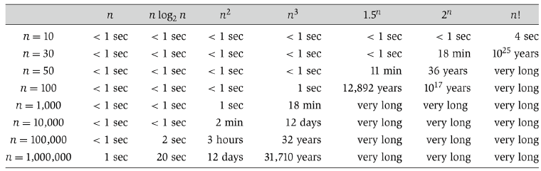
RUNNING TIMES
Running times for algorithms
  On processor executing million instructions per second

Slide 14
ASYMPTOTIC NOTATION
Asymptotic Efficiency
  How running time of algorithm scales with increasing input size in limit
Goal to identify similar classes of algorithms with similar behavior
  Measure running times in number of primitive “steps” algorithm must perform

Slide 15
ASYMPTOTIC BOUNDS
Not necessary to be precise about running times
  Care about rates of growth
Represent asymptotic running time of algorithm
  Growth rate relative to input size
  Independent of constant factors

Slide 16
ASYMPTOTIC UPPER BOUNDS: O-NOTATION
Given function T(n) representing algorithm’s running time
  T(n) is O(f(n)) (“T(n) is order f(n)”)
  For sufficiently large n, T(n) bounded above by constant multiple of f(n)
Definition
  Given g(n), O(g(n)) denotes set of functions
  O(g(n)) = {f(n) : there exists positive constants c and n₀ such that 0 ≤ f(n) ≤ cg(n) for all n ≥ n₀}
O(g(n)) is set, but usually notation abused
  f(n) = O(g(n))

Slide 17
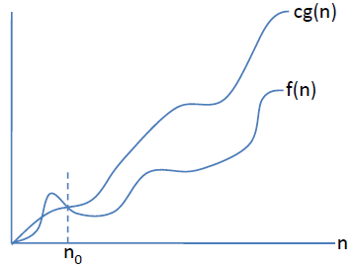
O-NOTATION
For all values of n to right of n₀
  Value of f(n) on or below cg(n)
  g(n) upperbound for f(n)

Slide 18
O-NOTATION: EXAMPLE
T(n) = pn² + qn + r is in O(n²)
  T(n) = pn² + qn + r ≤ pn² + qn² + rn² = (p + q + r)n² for all n ≥ 1
Required definition of O(⋅):
  T(n) ≤ cn², where c = p + q + r

Slide 19
O-NOTATION: EXAMPLE
an + b in O(n²)

Slide 20
O-NOTATION: EXAMPLE
Binary search in O(N)

Slide 21
O-NOTATION
Some texts use O to informally describe asymptotically tight bounds
O-notation useful in quickly and easily bounding running time of algorithm by inspection

